Slide 1
Build-a-thon: Demo of Deriving new use cases based on link prediction algorithm for FG AN use cases
By: Tarek Mohamed
Activities are done as part of ITU FG AN Build-a-thon 2022
Presented during Workshop 3.0
29 Nov 2022

Slide 2
Contents:
Problem.
Existing Solution.
New Mechanism of discovering use cases.
Why use this new mechanism.
Results and Conclusion.
Recommendations for better results..

Slide 3
What Is the problem?
Autonomous Networks has gained a lot of reputation and importance, specially in the next generation networks.
Although the huge interest for all firms, there are undiscovered potentiality of using it more in different use cases.
By Applying Link prediction algorithm, we tried to investigate these new potential use cases, by predicting possible links between Actors.
ML
src
sink
Example of closed loop use case, represented in graph, with AI/ML model as one of the actors.

Slide 4
How do we discover new use cases ?
In these days, we depend on the human actor to test and discover manually the new use cases.
Time and effort are the main factors here.
We have new cases came every day that need an expert to check for it.
src-2
ML-1
src-1
sink
ML-2
src-3

Slide 5
Building A Pipeline to get new cases:
Use cases Document
Generate
Reference Code
Parsing
Meta data
Parsed Figures
Graphs
Graph Representation
Requirements
Link Prediction
Supposed to produce

Slide 6
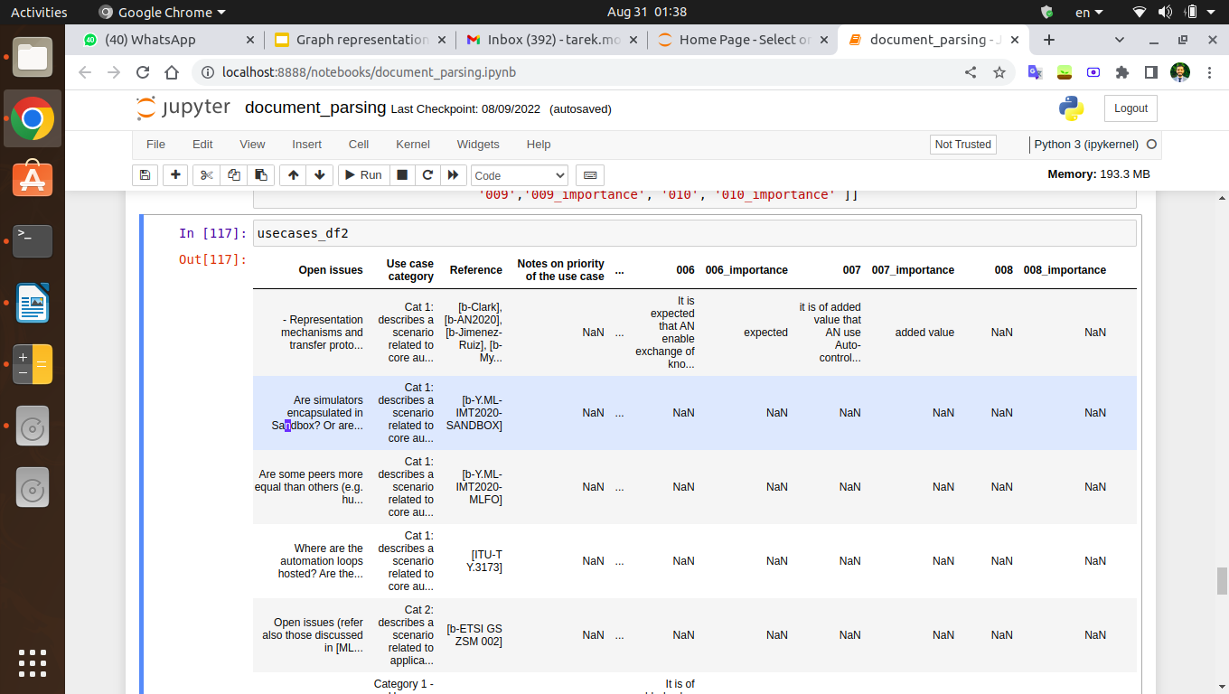
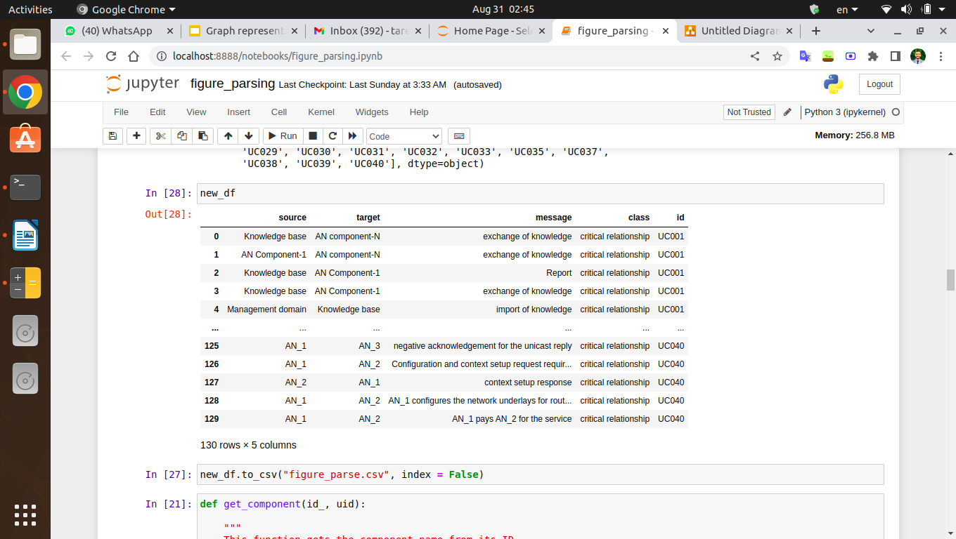
Parsing
Requirements
Meta Data
Figures
PlantUML
Draw.io
Text Parsing final table
Relations Parsing final table
Boxes Explained: 1. Parsing

Slide 7
Only Document Figures Representation
First Scenario
Adding Additional Properties
Calculated Combined features
Predict New links
Pure reference code representation
Second Scenario
Added Functions as properties representation
Third Scenario
2. Link Prediction

Slide 8




Why Use This Pipeline?
Fully Automated
Minimize Effort
Scenario independent
Minimize time

Slide 9

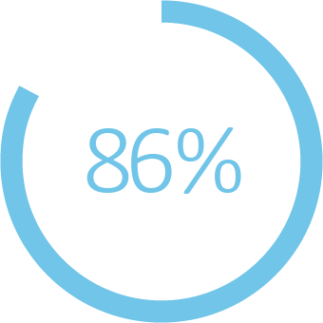

Results and conclusion:
Third scenario representation
Draw.io
Random Forest
Adding node properties
Link Prediction Accuracy

Slide 10
Recommendation For Better Results:
Names of the fields of document table must be consistent.
We need to find a parsable way to represent the sequence diagrams of the use cases.
Reference code may be enhanced more.
Include Sequence diagram representation for all use cases.
Make the representation aligned with the use case description and requirements.
[Next step] May Include NLP ML Models to help.
[Next Step] May use Other Graph Algorithms.
[Next Step] Use Other ways to represent the graph network i.e. Networkx library.
[Next Step] Applying Node Property Prediction.

Slide 11


